Slide 1


Probabilistic Modeling
Laetitia Dos Santos
Ingrid Da Silva Brito
Rodrigue Branchet—Fauvet
Lenny Joseph

Slide 2
Introduction
Probabilistic modeling is a statistical technique used to consider the impact of random events or actions in predicting the potential occurrence of future outcomes.
While a deterministic model gives a single possible outcome for an event, a probabilistic model gives a probability distribution as a solution.

Slide 3
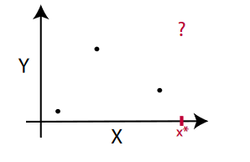
Visual representation of what uncertainty is and allows us to better understand that in order to make predictions we need to make assumptions.

Slide 4

Chapter’s examples
1. Predicting stocks with confidence
Platt scaling / Naive Bayes / Isotonic regression
2. Estimating customer lifetime value
The BG/NBD model / The Gamma-Gamma model
3. Diagnosing a disease
Aleatoric uncertainty / Negative log-likelihood/ Bernoulli distribution
4. Stopping credit defaults
Epistemic uncertainty

Slide 5
Predicting stock prices with confidence
In the stock market price in order to improve the performance of self-forecasting, it is crucial to summarize and accurately express internal fluctuation rules from the historical time series dataset.
Accurate predictions of future fluctuation for financial data can help investors hedge against risk.

Slide 6
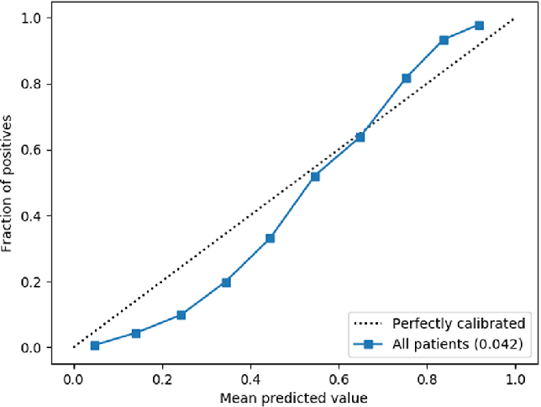
The concept of calibration of probability
The main objective of calibration is to adjust the prediction of a model in order to make the probability meaningful It will assess the model quality, the model impact and it will bring fairness and try to avoid bias.
Consequently, Probability calibration is the process of calibrating a machine learning model to return the true likelihood of an event.

Slide 7

How do we calibrate our stock market price
1st Step : Featurization
Featurization is the process to convert varied forms of data to numerical data which can be used for basic machine learning algorithms.
In our case we are focused on predicting individual prices, so our observational unit is a single stock price. For each price, we need to extract features, other prices running up to it. We extract prices across a time period that can help us predict future values. We will be normalizing stock price data on a daily time frame.
The benefit is that whatever the price range was originally, after normalization the price will be ranging in an interval between 0 and 1

Slide 8
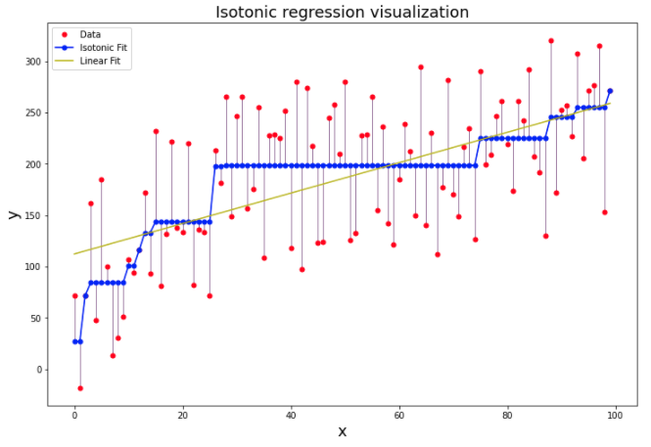
2nd Step : Use of Platt Scaling or Isotonic Regression
Some algorithms are fit in such a way that their predicted probabilities are already calibrated. Other algorithms do not directly produce predictions of probabilities, and instead a prediction of probabilities must be approximated.
Platt Scaling. (Use logistic regression model to transform probabilities.)
Isotonic Regression
Platt scaling is a simpler method and was developed to scale the output from a support vector machine to probability values. It involves learning a logistic regression model to perform the transform of scores to calibrated probabilities.

Slide 9
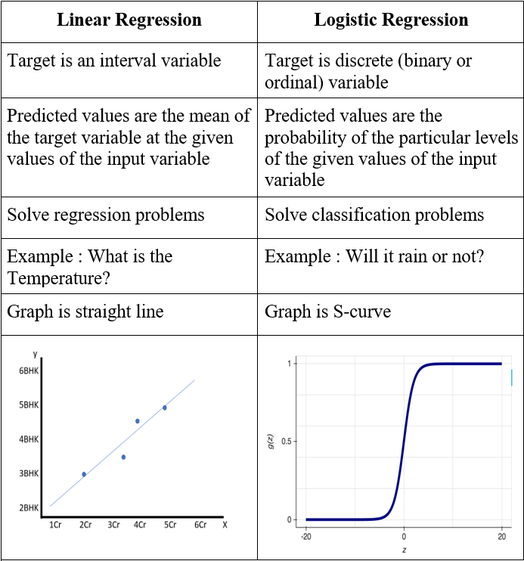
What is Logistic Regression?
The logistic regression will give you an S shaped “logistic function”. That curve goes from 0 to 1 on the Y, so it allows a binear classification this will tell us if the data is true or false.

Slide 10

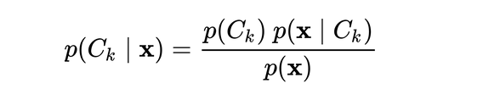
Naive Bayes
Naïve Bayes algorithm is a classification technique which generates Bayesian Networks for a given dataset based on Bayes theorem.
It assumes that the given dataset contains a particular feature in a class which is unrelated to any other feature.

Slide 11
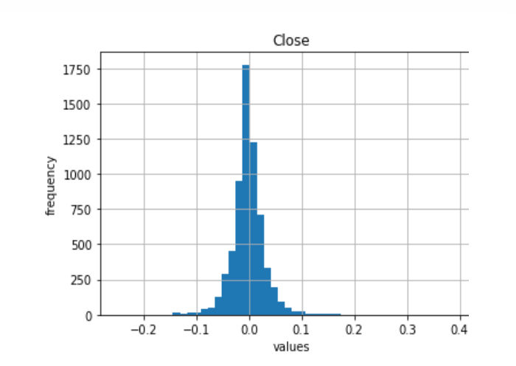

Slide 12

Estimating customer lifetime value
Customer Lifetime Value (CLTV) represents the total amount of money a customer is expected to spend in a business during his/her lifetime.
Two differents probabilistic forecasting models are used on each customer:
Modeling the likelihood of buying more products
Modeling the average value (revenue) of purchases

Slide 13
BG/NBD
BG/NBD will model each customer's purchase behaviors' distribution and will predict the expected number of transactions for each customer.
How many transactions will be next week?
How many transactions will be in the next 3 months?
Which customers will do the most purchases in the next 2 weeks?

Slide 14
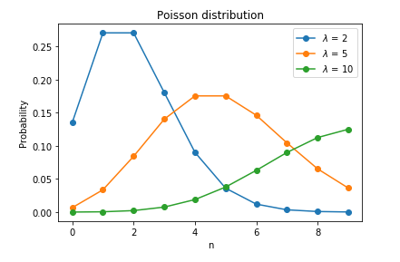
Poisson distribution
When a user is active, a number of his or her transactions in a time period of length t is described by Poisson distribution with transaction rate λ.
Poisson distribution helps to predict certain events happening using the data about how often event occurred in the past.

Slide 15
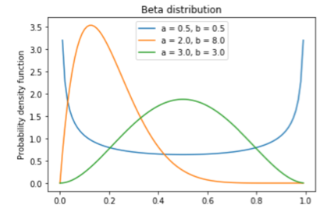
Beta distribution
Beta distribution is the best for representing a probabilistic distribution of probabilities

Slide 16
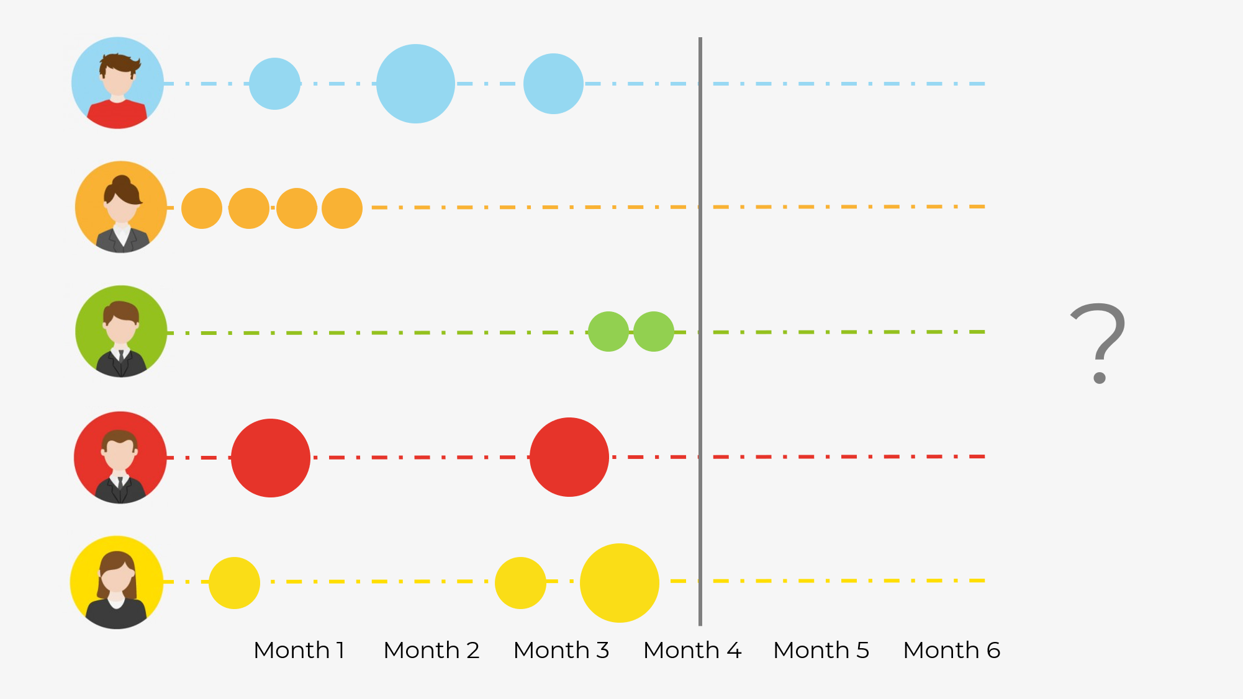
Gamma Gamma model
It will model the expected average profit distribution and will predict the expected average profit for each customer.
A customer’s monetary value will be random distributed around the average of its transaction values
An average transaction value can change in periods between the customers but it's not changing for a customer
The average transaction value will be distributed gamma between all customers

Slide 17


Slide 18

Diagnosing a disease
In this part we will try to understand how Machine Learning (ML) can diagnose a disease and with which tools it can do so.

Slide 19
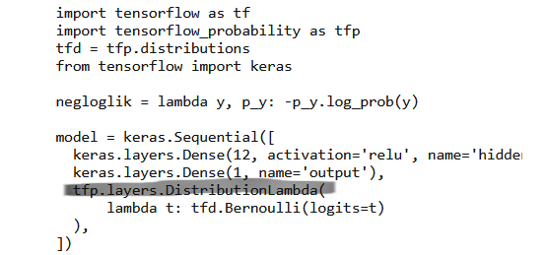
Creating a neural network
This DistributionLambda will allow us to get Aleatoric uncertainty which refers to the stochastic (random/hasard) variability of our outcomes given the same input.

Slide 20
Negative log-likelihood
The use of the negative log-likelihood is very relevant and is used for the classification of the probabilities.
Indeed, we want to maximize the probability of choosing the right category/class of probabilities from the training model.
We can maximize by minimizing the negative log-likehood, as you can see, we want to maximize by minimizing.

Slide 21
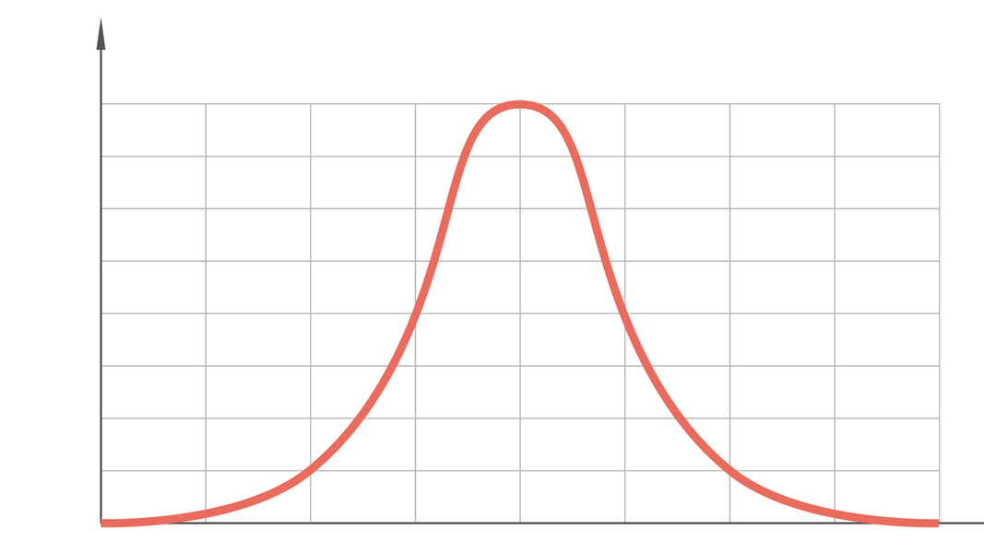
Bernoulli distribution
A Bernoulli distribution is a discrete distribution with only two possible values for the random variable.
The distribution has only two possible outcomes and a single trial which is called a Bernoulli trial.
The two possible outcomes in Bernoulli distribution are labeled by n=0 and n=1 in which n=1 (success) occurs with probability p and n=0 (failure) occurs with probability 1-p, and since it is a probability value so 0<=p<=1.

Slide 22
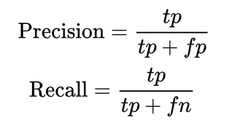
Bernoulli Distribution
The last step is to make a recall and precision. It will give us the “True Positives (tp), False Positives (fp), and False Negatives (fn)”.
So, that last part will assess and correct, if necessary, the precision of our Bernoulli outcomes.
All that we did during this example was to classify and to look after the best and the more precise class or category of probabilities. Because in this case we can’t let us have a margin of error. People's lives depend on that probabilistic analysis.

Slide 23
Stopping Credit Defaults
Method used by companies that extends credit to its customers, in order to avoid default and be profitable.
Through Credit Scoring ( gathering and analysing data to determine if a customer is solvent or not)
Scorecards are checklist of differents items of information associated to points that are added up in the end and compared to a pass mark.

Slide 24
Stopping Credit Defaults
Small dataset of credit card applications are in this process
Provide the firm insights into how do a credit card scoring with neural network models
The model includes a distribution weights and a distribution of outputs (epistemic/aleatoric uncertainty)
Epistemic provide better information about how trustworthy predictions are

Slide 25

Stopping Credit Defaults
The Coding is composed of 3 phases:
Download and preparation of the dataset
Creation of a model
Validation

Slide 26
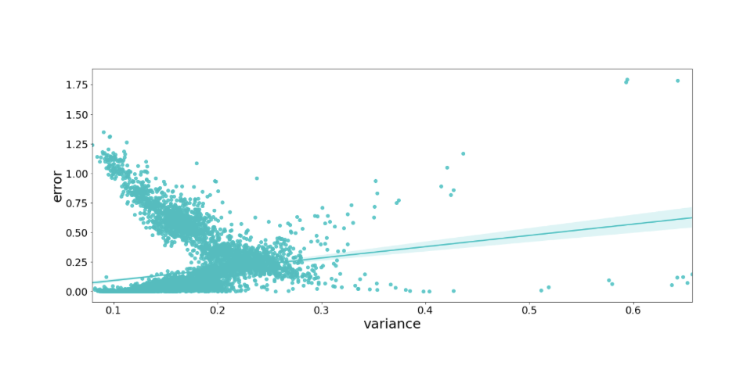
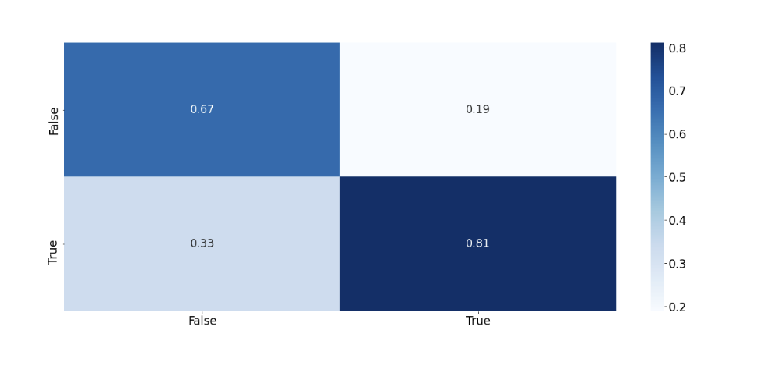
import scipy
scipy.stats.spearmanr(np.abs(y_test - preds.mean().numpy().squeeze()), preds.variance().numpy().squeeze())

Slide 27
Stopping Credit Default
Epistemic Uncertainty
Uncertainty related to incomplete information
In the TensorFlow Probability, it can be modeled as weight uncertainty
In Bayesian neural work (we treat the weights and outputs as the variables and we are finding their marginal distributions that best fit the data) weights are a probability distribution rather than scalar estimates.

Slide 28

Conclusion
With probabilistic modeling we try to get as close as possible to a possible future without overestimating or underestimating our data.

Slide 29
Sources
https://ethz.ch/content/dam/ethz/special-interest/bsse/borgwardt-lab/documents/slides/CA10_probabilitytheory.pdf
Probabilistic: Definition, Models and Theory Explained - Statistics How To
What Are Probabilistic Models in Machine Learning? - DEV Community
https://machinelearningmastery.com/calibrated-classification-model-in-scikit-learn/
https://tcoil.info/normalize-stock-prices-and-time-series-data-with-python-2/
https://youtu.be/TEbLUhHqLgE

Slide 30
https://github.com/RodrigueBranchet/BidData_probabilistic_modeling

